Slide 1
Pattern Matching
.* you want to know

Slide 2
Text matching: Globbing
Presentation-1.pdf
presentation.pdf
Presentation-1.pdf
presentation-1.pdf
presentation-*.pdf
presentation.*
presentation-2.pdf
presentation-2.*
xyz

Slide 3
Text matching: Regular expressions
Presentation-1.pdf
presentation.pdf
Presentation-1.pdf
1
^P.*$
presentation-\d.pdf
presentation.*
.*
presentation-2.pdf
presentation-[^1]
xyz

Slide 4
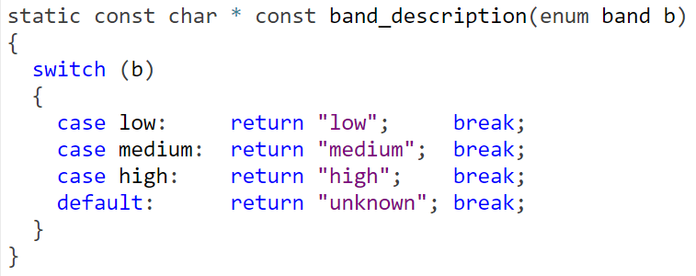
C-style languages

Slide 5
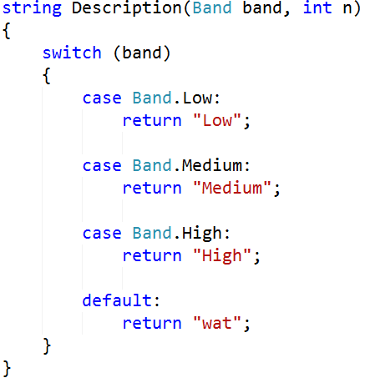
C-style languages

Slide 6
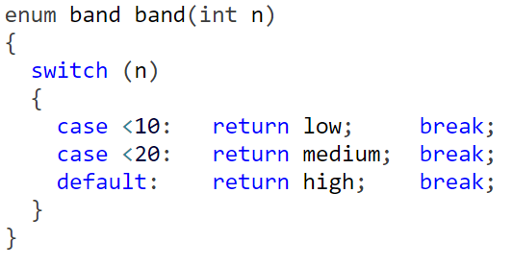
But that’s too static

Slide 7
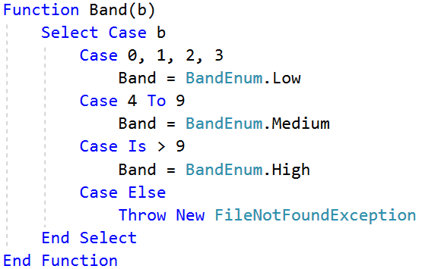
*cough*

Slide 8
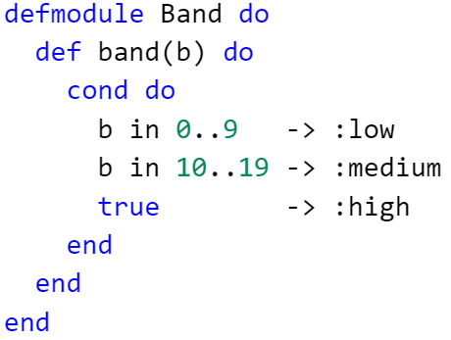
Elixir
More highly-regarded languages have pattern matching, too

Slide 9
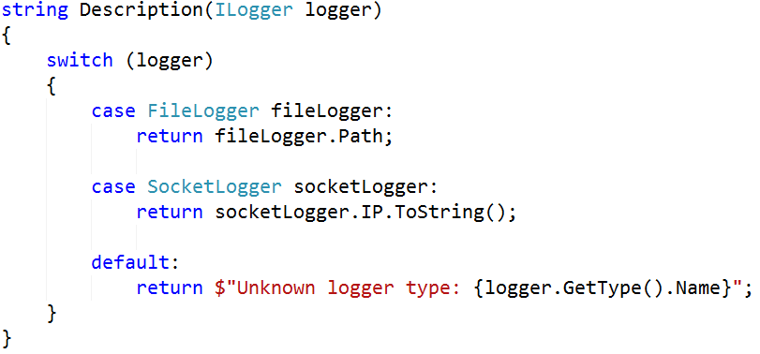
C#7

Slide 10
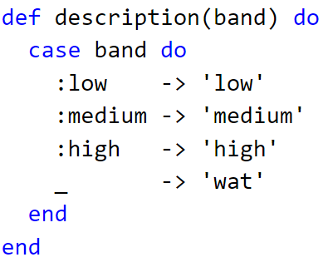
Guard clauses - beginnings

Slide 11
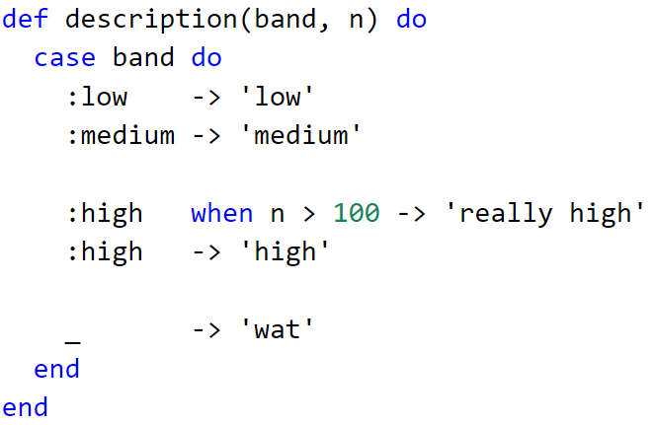
Guard clauses - Elixir

Slide 12
Guard clauses - Elixir

Slide 13
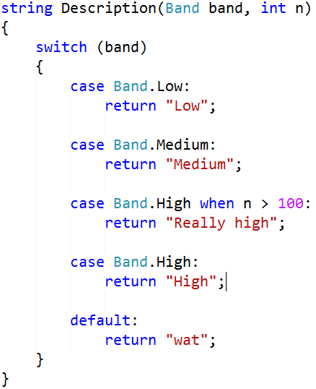
Guard clauses – C#

Slide 14
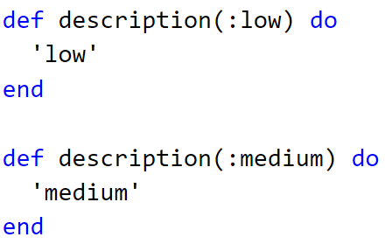
Matching in method signatures

Slide 15

Matching in method signatures

Slide 16
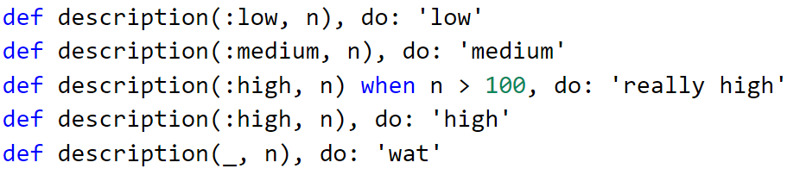
MOAR

Slide 17
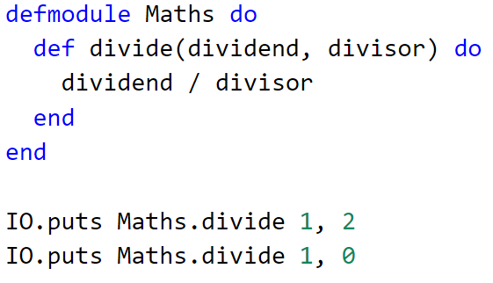
But why?
** (ArithmeticError) bad argument in arithmetic expression

Slide 18
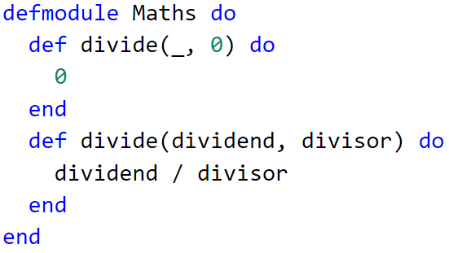
Because decluttering

Slide 19
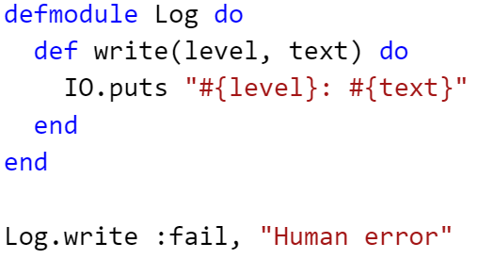
Idiomatic?

Slide 20
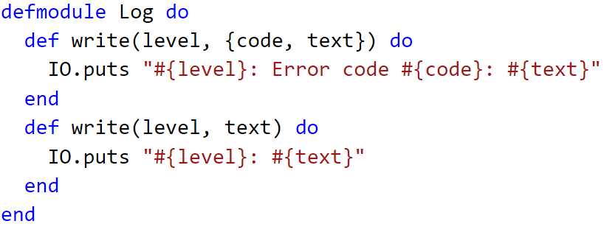
Just overloading based on signature

Slide 21
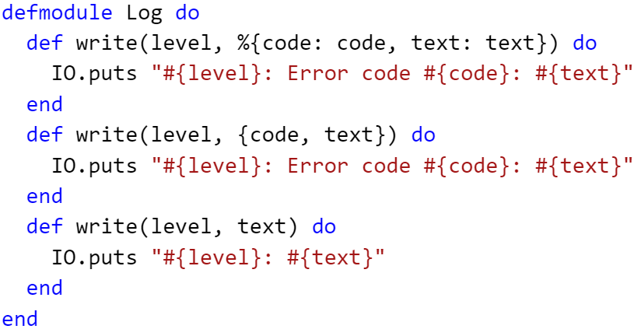
Hash, tuple or string

Slide 22
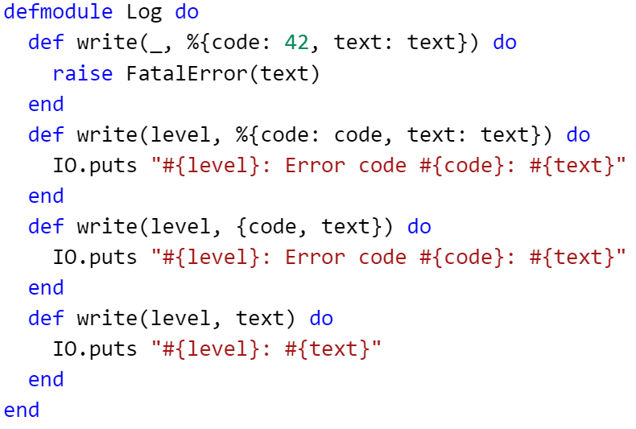
Match on value contained in value (!)

Slide 23
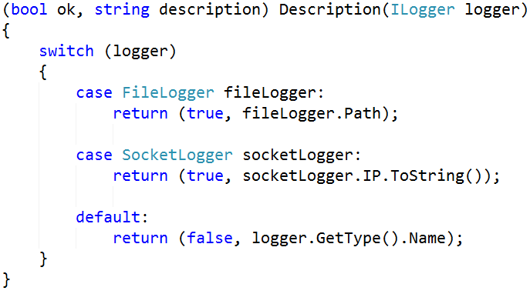
Destructuring return values

Slide 24
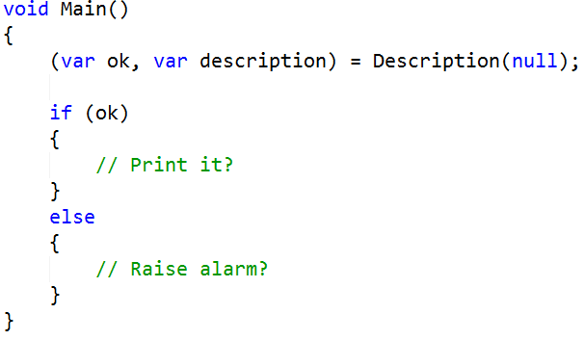
Destructuring return values

Slide 25
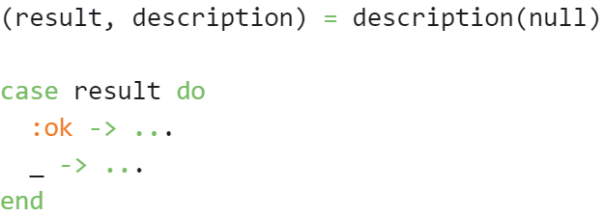
Destructuring return values

Slide 26
Matching return values

